Slide 1
Predictive analysis of stroke risk factors and contributors
Team 1
Ramirez Moreno Diana Gabriela
Medina Gómez Alejandro
Sánchez Zepeda Esteban Tonatiuh
Castro Chabolla Rodolfo
Datasets to be used: Stroke Prediction Dataset

Slide 2
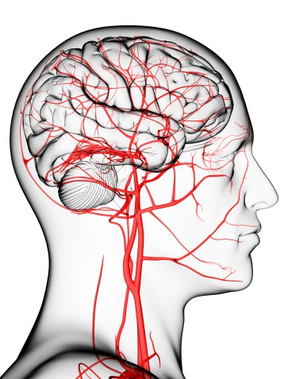
Objective:
Identify the key risk factors and contributors that affect stroke prediction and identify the patients at high risk of stroke.

Slide 3

Project Description / Outline:
An ischemic stroke occurs when the blood supply to part of the brain is interrupted or reduced, preventing brain tissue from getting oxygen and nutrients. Brain cells begin to die in minutes.
A stroke is a medical emergency, and prompt treatment is crucial. Early action can reduce brain damage and other complications. Predicting the likelihood of stroke can help to prevent and manage the disease.
This project aims to identify the key risk factors and contributors that affect stroke prediction using a large dataset. The goal is to identify and analyze the risk factors that could increase the probability of a patient getting a stroke.

Slide 4
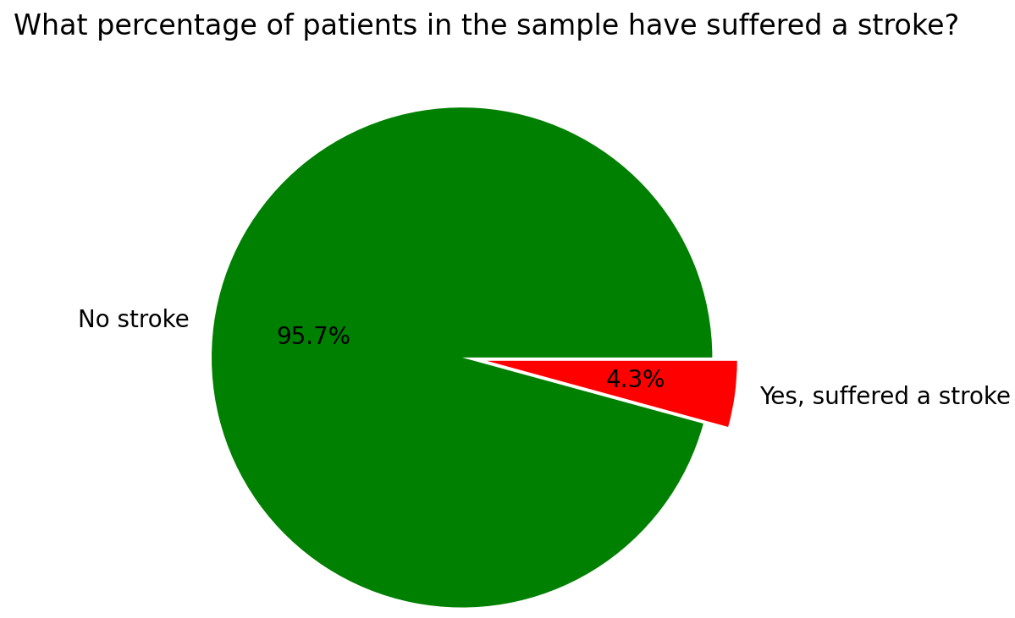
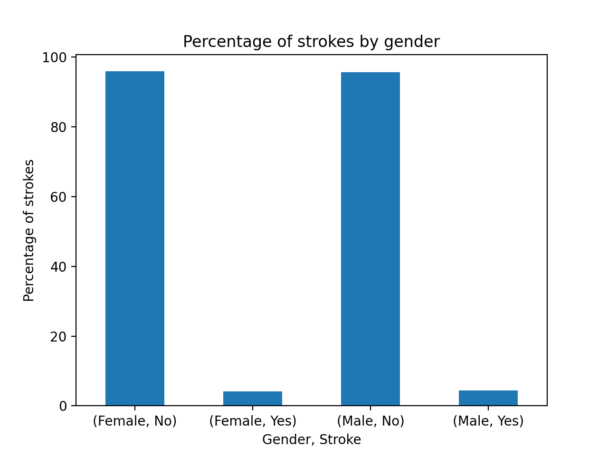
Data overview
After cleaning the data for NaN and Null values, the dataset was reduced from an initial population of 5110 to a refined population of 4908.
Among these individuals, approximately 4.3% were reported to have suffered a stroke.
 | Pop total | Suffered a stroke
Female | 2897 | 120 (4.14%)
Male | 2011 | 89 (4.43%)
*There is not sufficient evidence to support the claim that women are more likely to have a stroke than men

Slide 5
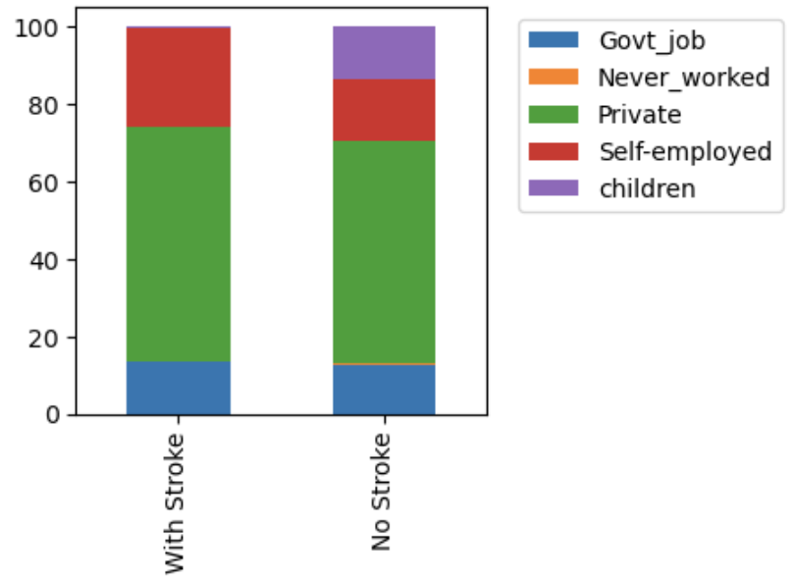
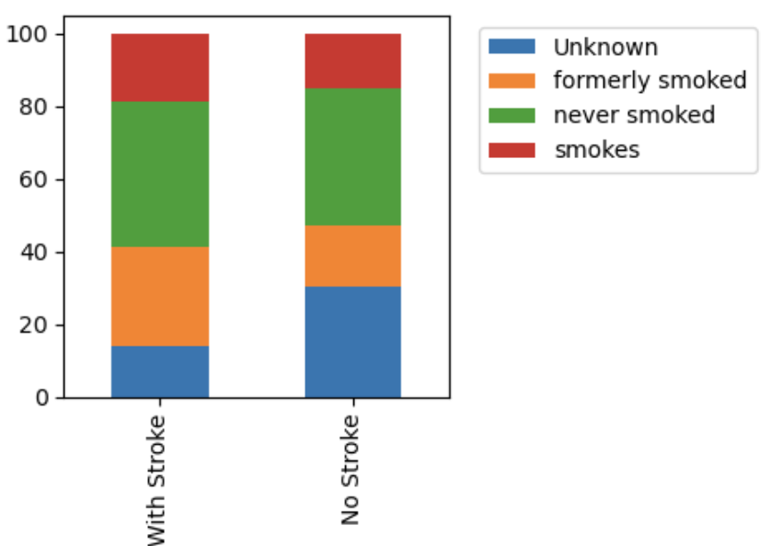
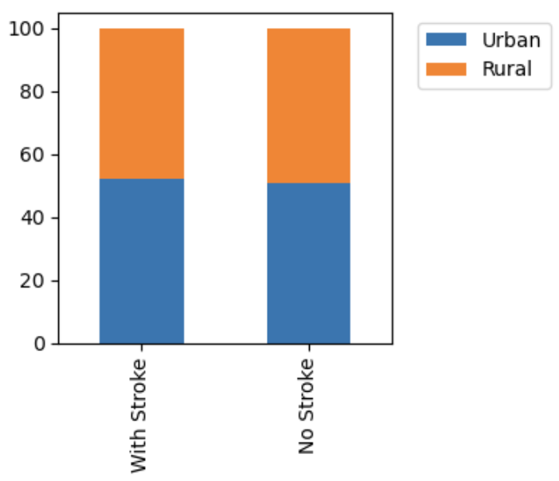
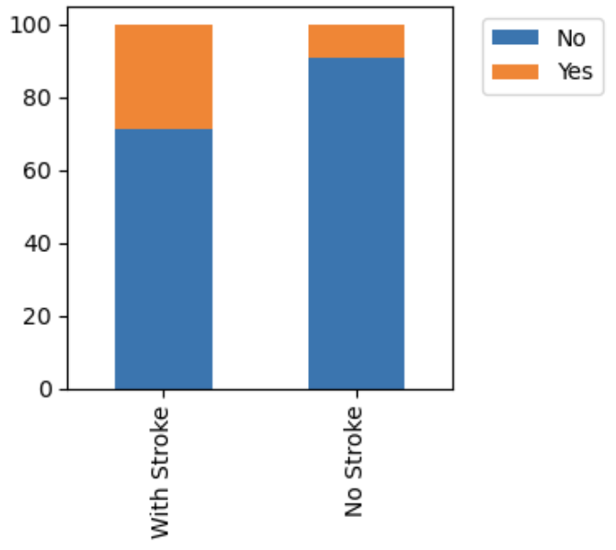
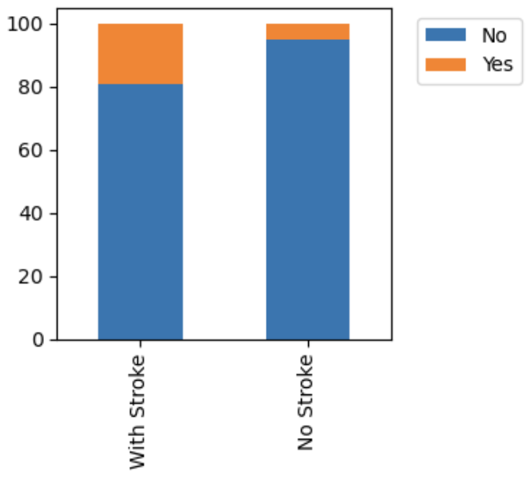
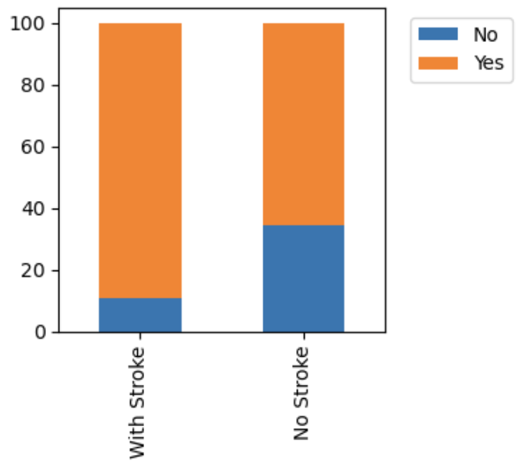
What is the correlation between the variables?
Work Type
Smoking
Residence Type
Stroke Patients are Overdeveloped in:
Self Employment
Formerly Smokers
Married
Hypertension
Heart Disease
Glucose levels
Age
Factors balanced vs. Non Stroke: Residence & BMI
Hypertension
Heart Disease
Ever Married
Average Values | Stroke | No Stroke
BMI | 30.5 | 28.8
Glucose | 134.5 | 105.2
Age | 67.7 | 42.8

Slide 6
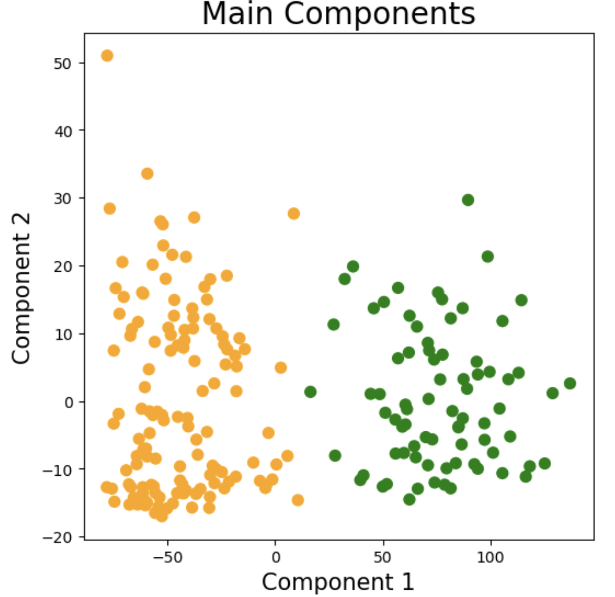
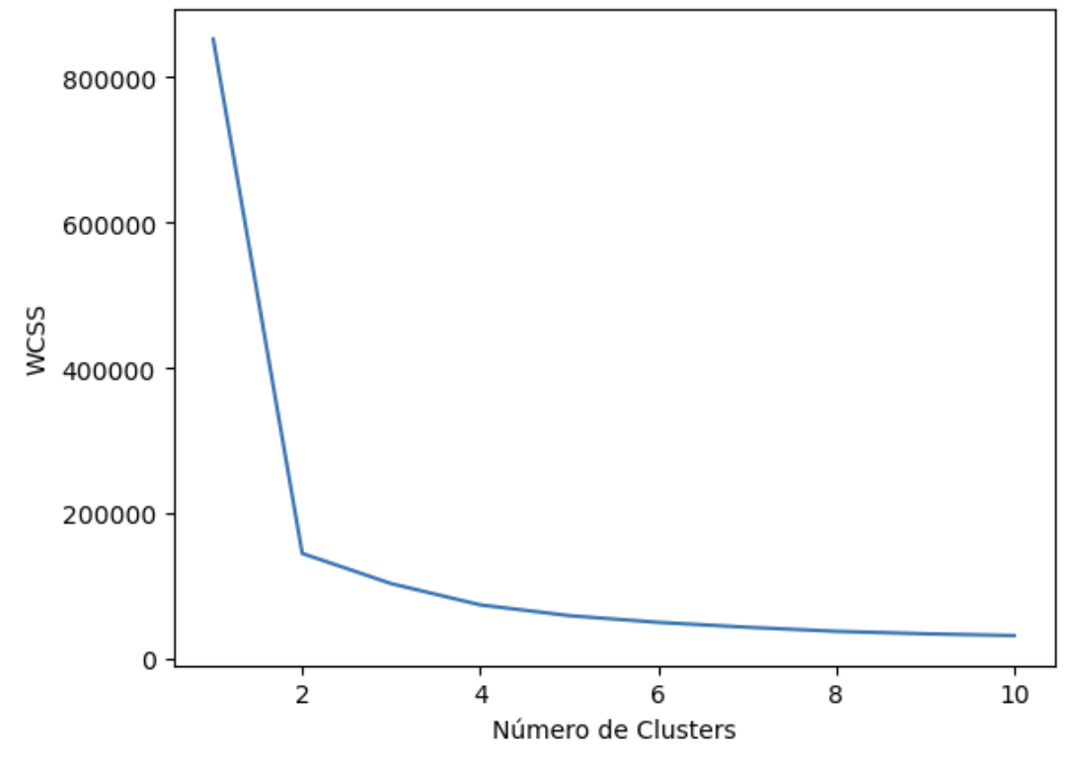
Can we cluster different attributes to better predict strokes?
We decided to make clusters within the Stroke patients to identify if there were different patient profiles that could allow us to predict strokes given different sets of conditions
In order to do this we had to get rid of categorical values to do a KMean analysis. We passed from a Data Frame of 14 columns to 21 Columns
We used the Main components method to demonstrate there’s no overlap in the clusters
Defining the number of clusters needed:
Used the Codo de Jambu method (Elbow Method)
Cluster 1
Cluster 2
WCSS is an indicator of how similar are the individuals within the clusters
The value of WCSS stopped the drastical diminish at cluster #2 thus this is the optimal number of clusters

Slide 7
Can we cluster different attributes to better predict strokes?
We compared the variables similarities and differences between clusters of patients that had suffered a stroke and also the patients without stroke to identify ranges, maximum values and possible main risk factors
Work Type
Gender
Residence
Smoking
 | age | hypertension | heart disease | ever married | avg glucose level | bmi | Govt_job | Private | Self-employed | children | Female | Male | Rural | Urban | Unknown | formerly smoked | never smoked | smokes
Stroke Cluster 1 | 69.49 | 0.38 | 0.29 | 0.95 | 210.69 | 33.1 | 0.14 | 0.65 | 0.21 | 0.0 | 0.52 | 0.48 | 0.47 | 0.53 | 0.1 | 0.3 | 0.4 | 0.19
Stroke Cluster 2 | 66.67 | 0.23 | 0.14 | 0.86 | 90.17 | 28.94 | 0.13 | 0.58 | 0.28 | 0.01 | 0.61 | 0.39 | 0.48 | 0.52 | 0.16 | 0.26 | 0.4 | 0.18
Non Stroke | 41.76 | 0.08 | 0.04 | 0.64 | 104.0 | 28.82 | 0.13 | 0.57 | 0.15 | 0.14 | 0.59 | 0.41 | 0.49 | 0.51 | 0.31 | 0.17 | 0.38 | 0.15
As initial observation we see that patients above 66-69 years old who has suffered hypertension and / or heart dis ease,married with glucose level around 210 showed more propensity to stroke
In order to get more accurate conclusions let’s analyze each variable separately

Slide 8
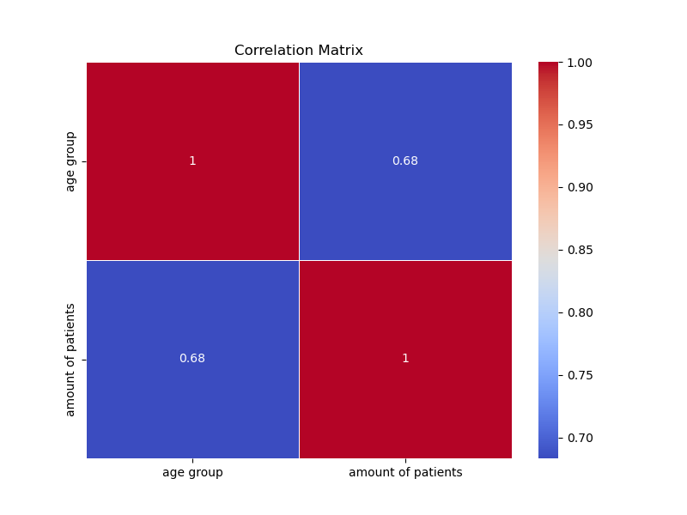
In what range of age is a person most likely to have a stroke
This correlation matrix shows the correlation coefficients between the two sets of variables, the color intensity and annotation values indicate the strength and direction of the correlation.
Interpreting the correlation matrix:
Looking at the correlation matrix heatmap, each cell represents the correlation coefficient between two variables. The diagonal cells represent the correlation of a variable with itself, which is always 1

Slide 9
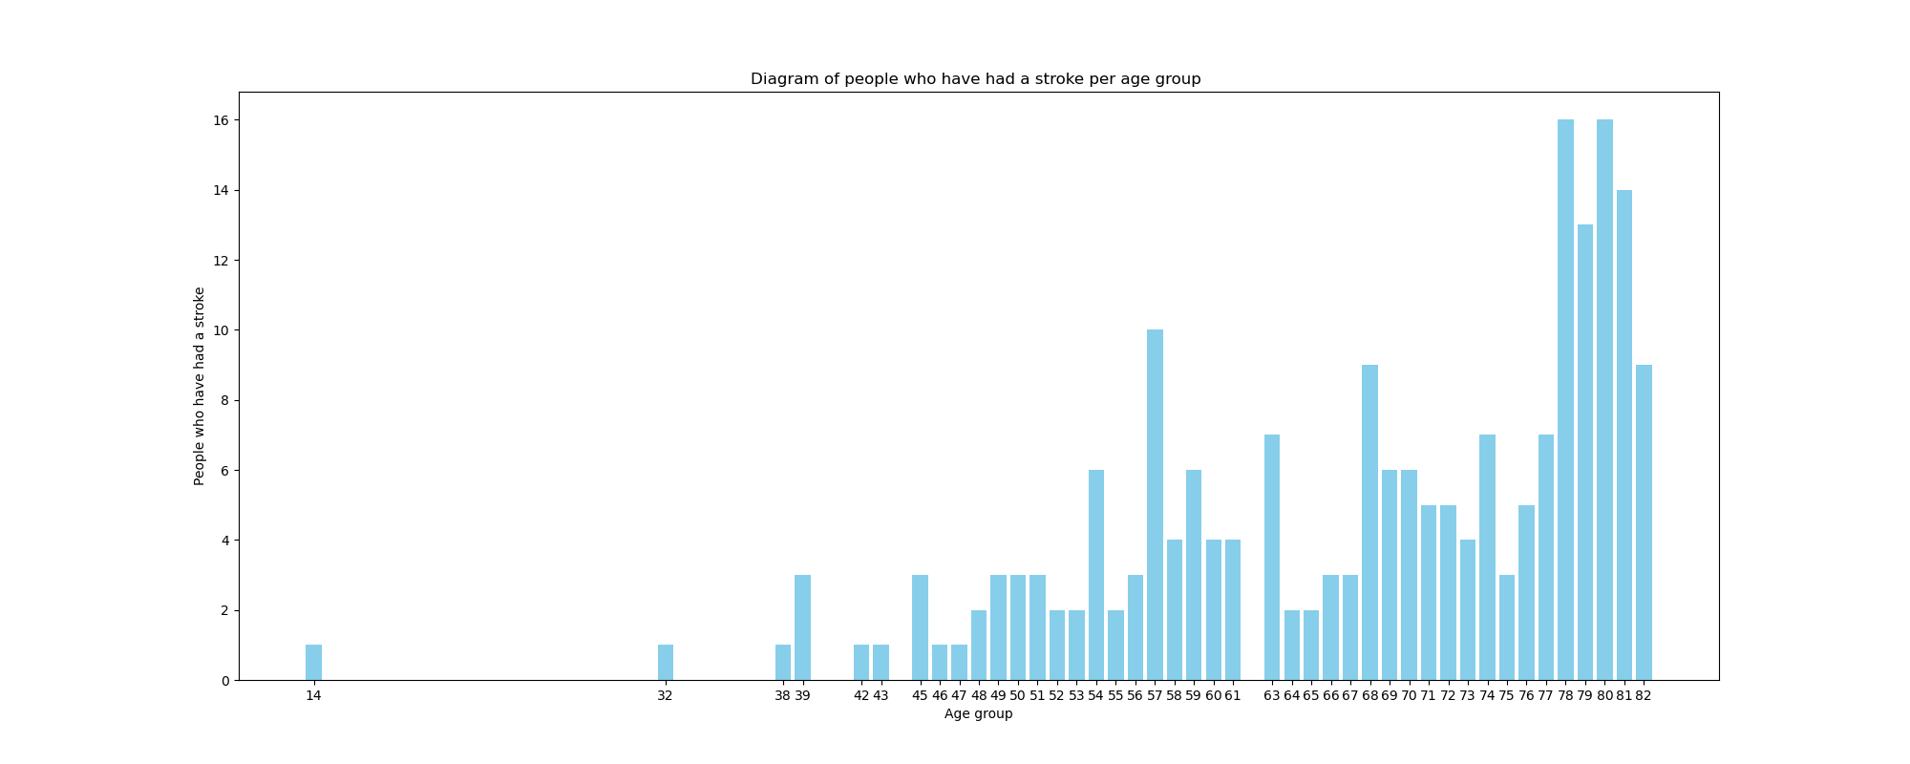
In what range of age is a person most likely to have a stroke
Age Group with the Most Patients: The age group with the highest number of patients is 78, followed by 80 and 81.
Age Group with the Fewest Patients: The age groups with the fewest patients are 14, 32, 38, 42, 43, 46, and 47, each having only 1 patient.

Slide 10
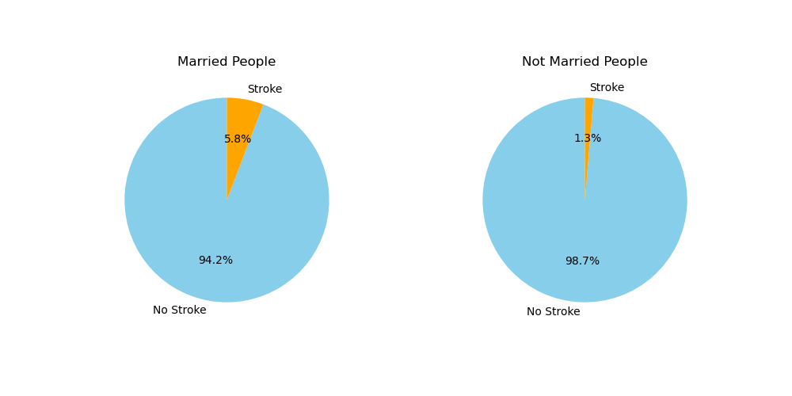
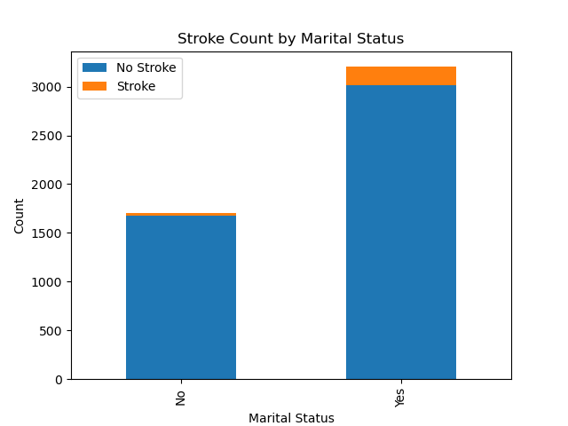
Is being married a key factor in increasing the probability of having a stroke?
We can see that the Marital status does not affect significantly whether if a patient is more likely to have a stroke or not

Slide 11
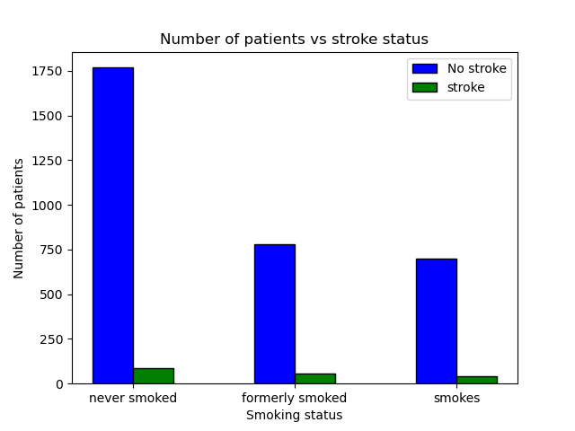
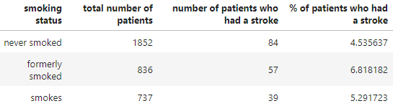
Is smoking a key factor in increasing the probability of having a stroke?
Answer : No, smoking is not a key factor, But according to the hypothesis test and the analysis, smoking is a factor that can increase a little the likelihood of having a stroke
key factors* all those that significantly affect the increase in someone's likelihood of having a stroke.

Slide 12
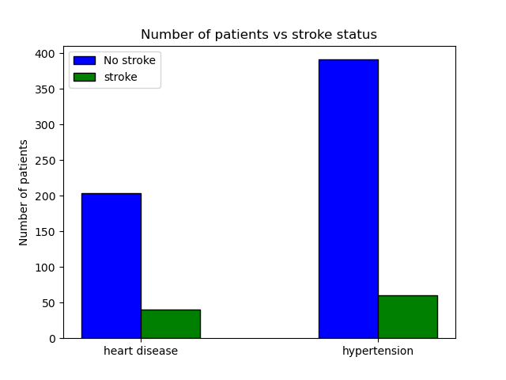
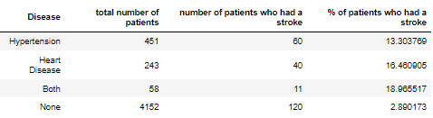
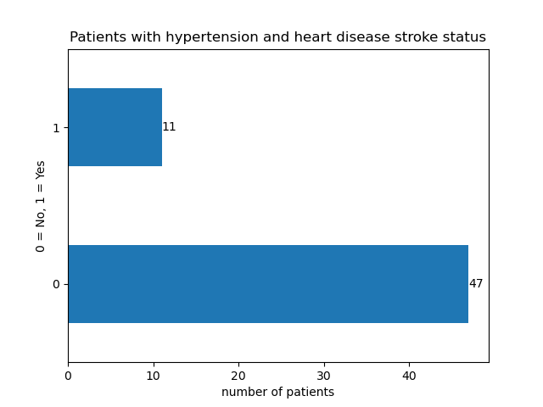
Is having a heart disease and/or hypertension considered as risk factor?
Answer: yes, having Hypertension and/or heart disease will increase the chances of someone having a stroke.
Risk factor* characteristics at the biological, psychological, family, community, or cultural level that precede and are associated with a higher likelihood of negative outcomes

